Slide 1

Community-level biodiversity
Wolfgang Kiessling
Paleobiology, FAU Erlangen
06. August 2024
Wolfgang Kiessling
Notes:
Perhaps better „assemblage-level“ biodiversity

Slide 2
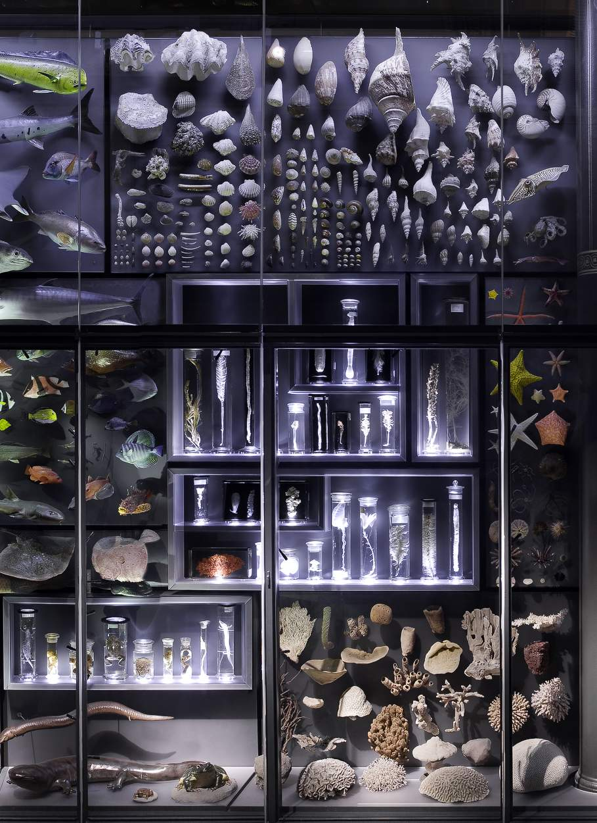
Biodiversity
The diversity of life in all its expressions on all levels of organization
Expressed by
Genetic diversity
Morphologic diversity
Resource partitioning (ecological or functional diversity)
Here: Number of taxa coexisting in a system
Species, Genera, Families

Slide 3
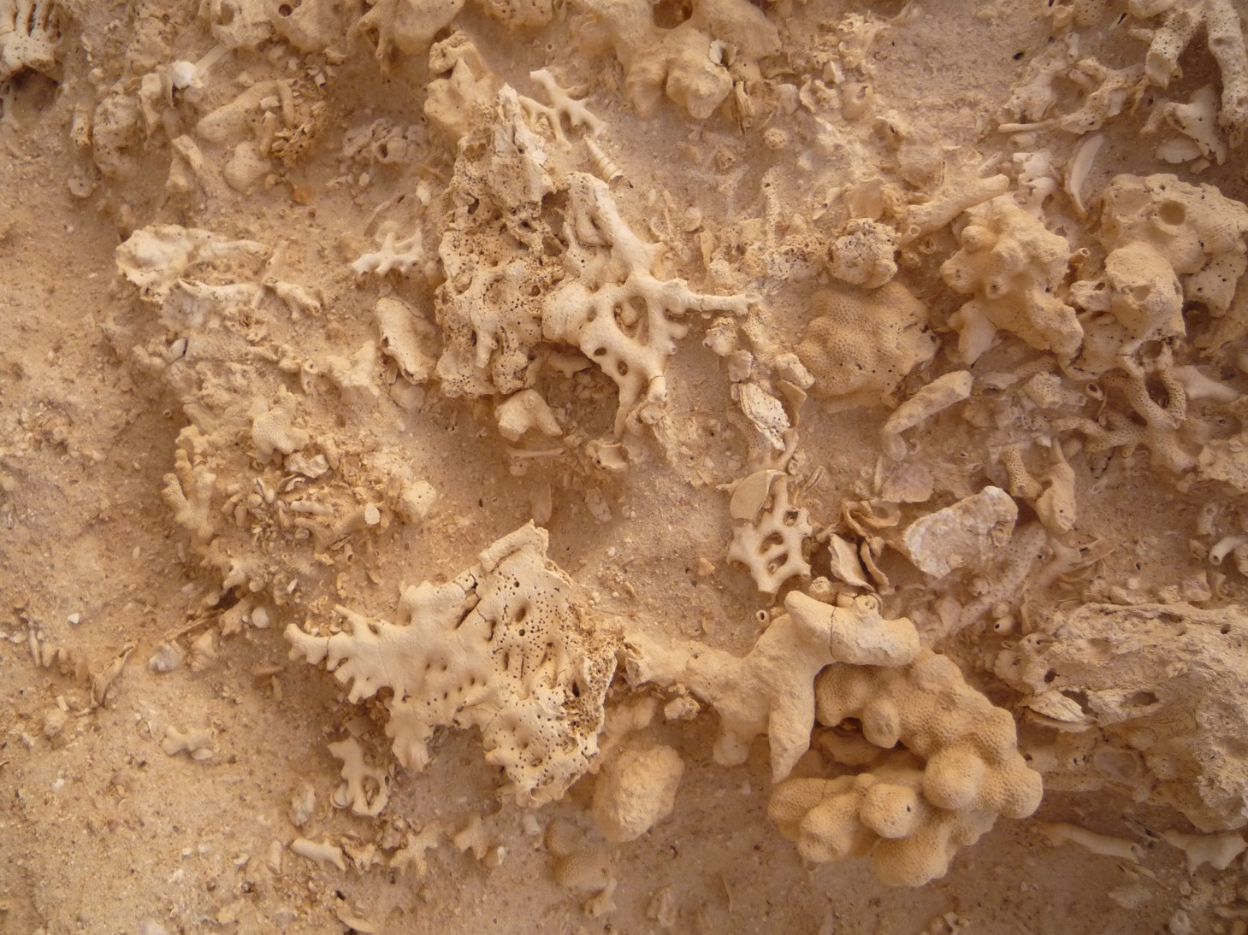
Communities, meta-communites, assemblages
Community?
Community: Interacting groups from different species living in a single habitat
Meta-communities: A set of local communities that are linked by dispersal of multiple potentially interacting species
In paleo we can only identify assemblages: a collection or group of fossils found in the same sedimentary rock layer
Notes:
But quantitative methods are the same

Slide 4
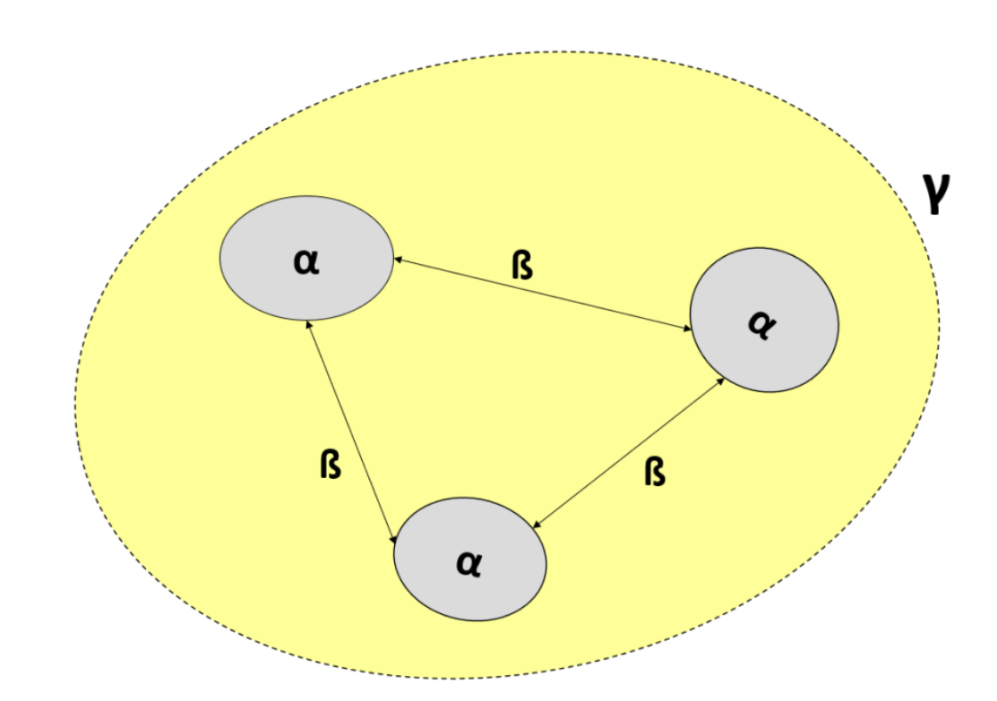
Structure
Definitions
Alpha, Beta, Gamma diversity
Alpha diversity through time
Measuring alpha
Beta diversity
Community dissimilarity
Multivariate approaches

Slide 5
Components of biodiversity
Point diversity (Alpha) = Within community diversity
Between community diversity (Beta)
Total diversity (Gamma): Area, region, or globe
Mean(Alpha) x Beta = Gamma
Notes:
Multiplicative

Slide 6
Exercise: Alpha, Beta, Gamma
Birds in three British habitats
Species | Wood | Hedge | Open field
A | X
B | X
C | X
D | X
E | X
F | X | X
G | X | X
H | X | X
I | X | X
J | X | X
K |  | X
L |  | X | X
M |  |  | X
N |  |  | X

Slide 7
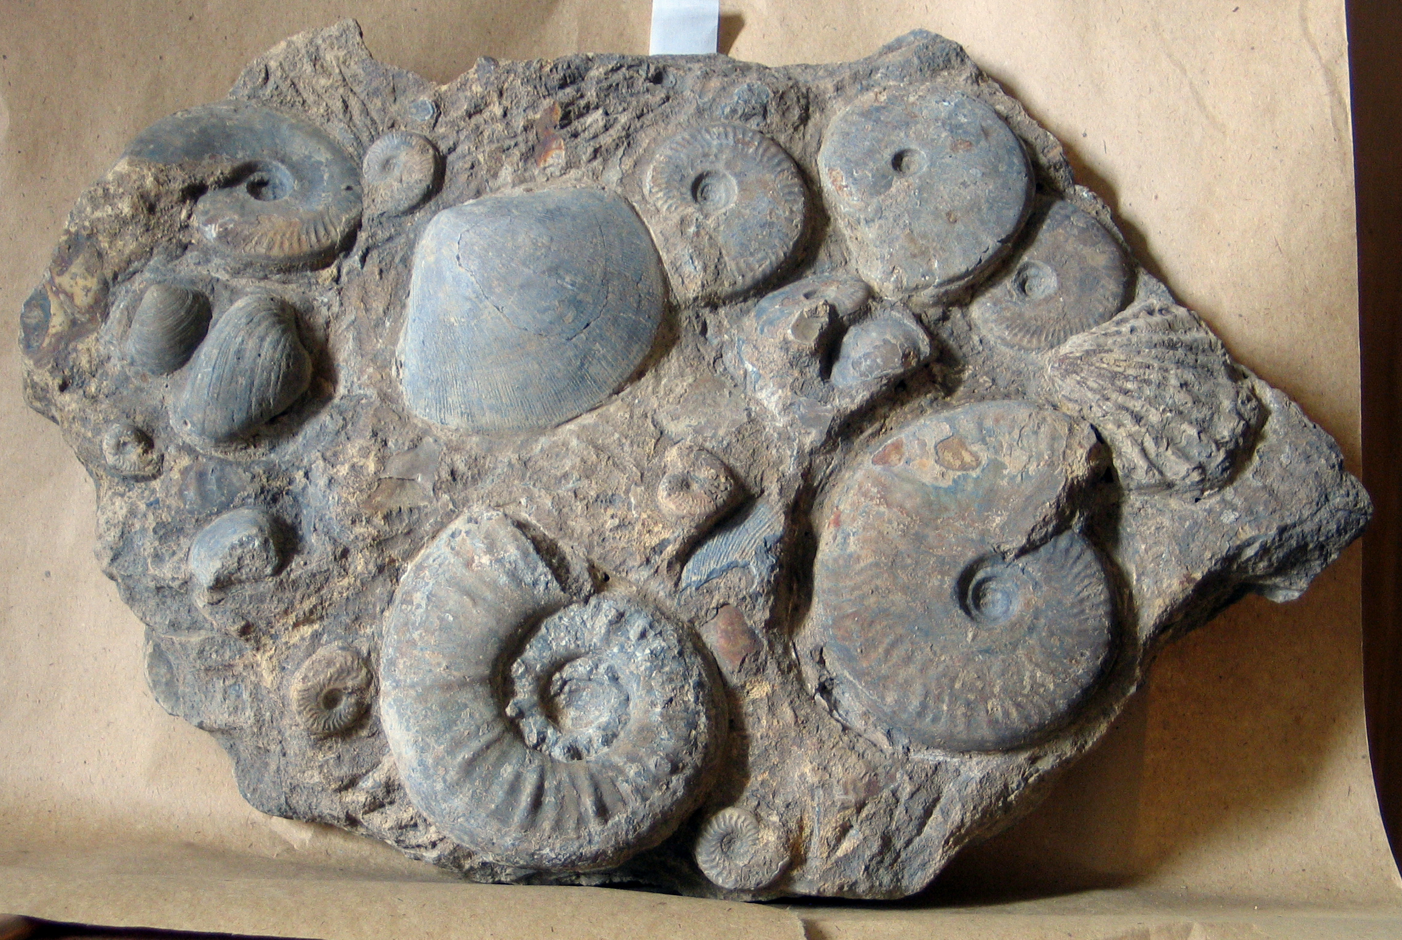
Alpha Diversity
Species richness (Number of species)
Abundance (Number of individuals per species)

Slide 8
Measuring Alpha Diversity
Simple Case
All species are equally common
Species numbers alone (S) provide sufficient information (but there is sampling bias)
Realistic case
Abundance distributions are strongly skewed
S isn‘t meaningful and sampling bias might be extreme
How to value relative abundances in diversity estimates?

Slide 9
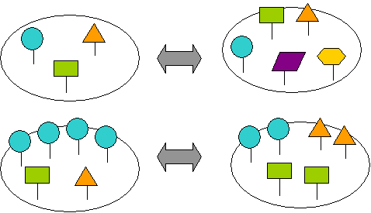
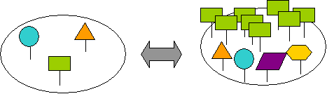
Alpha Diversity
Which community is more diverse?

Slide 10
Diversity Indices: Annotations
N = Number of Individuals
S = Number of Species
p = The proportion of a species (i) in a community
Most commonly used
Shannon-Wiener Information Index (H) aka Shannon Entropy
H = -∑ p_{i} x ln(p_{i})
p_{i} = Proportion of the i^{th} species in the community
Natural log most common, but sometimes also log₂ or log₁₀
Notes:
the cross entropy

Slide 11
Compute H for the two assemblages
H =
H =

Slide 12
Other common diversity metrics
Abundance distributions are considered or assumed to be log series
Simpsons D (Dominance)
D = ∑ p_{i}²
Diversity index: 1-D = 1- ∑ p_{i}²
Margalef-Index
D_{M} = (S-1)/ln(N)
Good if you only know gross totals
But only applicable to a log series distribution
Notes:
Simpson Diversity: Sometimes also 1/D
Simpson's Reciprocal Index

Slide 13
Fisher’s Alpha
Fisher‘s α based on assuming a log-series distribution
αx, αx²/2, αx³/3 ... αx^{n}/n
x number of species with one, two, three and n individuals
S = α ln(1+N/α)
α only determined iteratively
Calculate α for S = 30 and N = 400

Slide 14
Other Indices
Brillouin Index
N = total number of individuals
n = number of individuals in species x
Menhinick Index
D_{Mh} = S/√N
Berger-Parker Dominance
d = p_{max}

Slide 15
Most diversity indices are mixed signals of richness and evenness
Pure Evenness should only measure relative abundance distributions and be independent of richness
Evenness metrics
Evenness J = H/H_{max}
H_{max} = ln(S)
Equitability E = e^{H}/S
Hurlbert‘s PIE (Probability of Interspecific Encounter)
PIE =

Slide 16
Compute J for the two assemblages
J =
J =

Slide 17
Sampling Bias
Most indices are biased by sample size
Question: What diversity to expect if sample sizes were the same?
Problem: Relationship between sample size and diversity is not linear
N = 12
S = 3
N = 3
S = 2
Notes:
Will hear more about this tomorrow, but methods were originally developed in community ecology

Slide 18
Rarefaction
Interpolation biodiversity
Question: Which species richness would I observe if my sample A was smaller than it is (e.g., as small as sample B)
Equation:
(read N over n) = = N!/n!(N-n)!
E(S_{n}) = expected species richness; S = number of species; N_{i} = Individuals of species i, N = Individuals in total sample, n = Subsampling quota

Slide 19
Two Approaches to Rarefaction
Mathematic solution:
Apply the equation
Empirical solution:
Let the computer draw specimens at random and get diversity for a given sample size

Slide 21
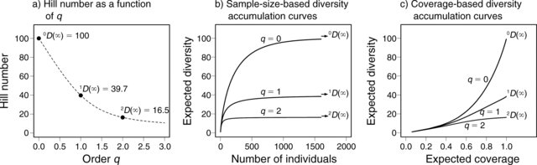
How to weigh rare species?
Critical question in diversity estimates
Rare species form the bulk of species richness but abundant species form the bulk of ecosystem services
Hill Numbers help to give variable weight to rare species

Slide 22
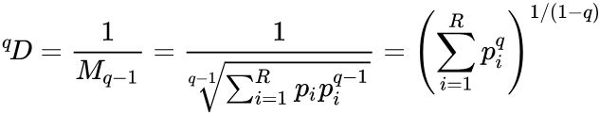
Hill Numbers
The effective number of species: the number of equally abundant types needed for the average proportional abundance of the types to equal that observed in the dataset of interest
q is the Hill order (aka order of diversity): basically the type of average that is sought
q = 0 weighted harmonic mean
q = 1 weighted geometric mean
q = 2 weighted arithmetic mean
Higher values of q give more weight to abundant species.
Hill, M. O., 1973, Diversity and evenness: A unifying notation and its consequences: Ecology, v. 54, no. 2, p. 427-432.

Slide 23
Hill Numbers
For q = 0
D = S
For q = 1 (given equal weight to rare and common species)
¹D = e^{H}
For q near infinity
The weighted generalized mean with exponent q−1 approaches the proportional abundance of the most abundant species
1/^{Inf}D = p_{max}
Notes:
For q = 2 you get Simpson's Reciprocal Index

Slide 24
Biodiversity Indices and Rarefaction
Diversity indices and rarefaction of a Middle Triassic benthic community from China
We go through the script in plenary and spend time on playing with Rarefaction
Script: Alpha_div_new.R

Slide 25
Rank-Abundance Distributions
Patterns of relative abundances
Major tool in Community Ecology
More information than in common indices
Straightforward interpretations
Resource utilization
Complexity of community

Slide 26
Relative Abundance of Species in Communities
Middle Triassic of China
Usual case: A few species are dominant and there are many rare species.

Slide 27
Presentation
Rank usually linear on x axis
Abundances (relative of absolute) on logarithmic scale on y axis

Slide 28
Examples
100
10
Broken Stick Model
Per Species Abundance
1
0.1
Log-Normal Series
0.01
Log Series
Geometric Series
0.001
10
20
30
40
Species Addition Sequence

Slide 29
Inferences
Evenness increases from Geometric series → Log series → Log-normal → Broken stick
Dominance decreases in same direction
Geometric: Simple community with niche pre-emption
Log-normal und broken stick: Complex community with diverse guilds coexisting with their own distributions

Slide 30
What model best describes the RAD of the Triassic community?
Try package “vegan” and function “radfit”

Slide 31
Model Selection with AIC
Akaike (1974): An Information Criterion
Mostly: Akaike‘s Information Criterion
“Penalize“ models for complexity (number of parameters)
AIC = -2*ln(likelihood) + 2*K
Likelihood → The fit of the model
K the number of parameters
The smaller the AIC the better
If n/K < 40 use small-sample size correction
AICc = -2*ln(likelihood) + 2*K + (2*K*(K+1))/(n-K-1)
Or BIC (Bayesian Information criterion)

Slide 32
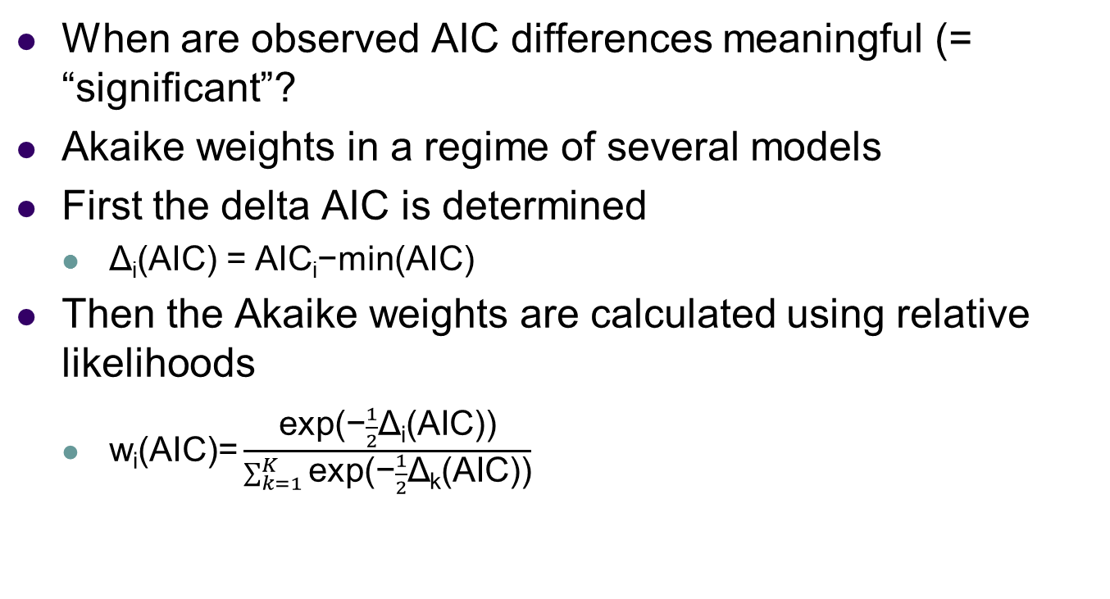
Model Selection with AIC
When are observed AIC differences meaningful (= “significant”?
Akaike weights in a regime of several models
First the delta AIC is determined
Δ_{i}(AIC) = AIC_{i}−min(AIC)
Then the Akaike weights are calculated using relative likelihoods
$\text{w}\text{i}\text{(}\text{AIC}\text{)=}\frac{\text{exp}\text{(−}\frac{1}{2}\text{Δ}\text{i}\text{(}\text{AIC}\text{))}}{\sum_{k=1}^{K}{\text{exp}\text{(−}\frac{1}{2}\text{Δ}\text{k}\text{(}\text{AIC}\text{))}}}$
Burnham, K. P., and Anderson, D. R., 2002, Model selection and inference: a practical information-theoretic approach, New York, Springer,

Slide 34
Terms in vegan
Resource-partitioning models
Null = Broken Stick = Normal
Preemption = Geometric Series
Lognormal = Lognormal
Statistical models (power law)
Zipf = Zipf → Strong dominance and a long tail of rare species
Mandelbrot = Zipf-Mandelbrot → Weaker dominance but a long tail of rare species
Notes:
Preemption = Vorwegnahme, Zuvorkommen, Vorkaufsrecht

Slide 35
Alpha Diversity Through Time: Richness
Two phases of increase (Cambro-Ordovician, Cenozoic) in normal marine habitats
One increase in variable environments and non in high-stress environments
Bambach (1977, Paleobiology)
Notes:
Seminal study but only based on raw data. Correct to simply take statistical averages?

Slide 36
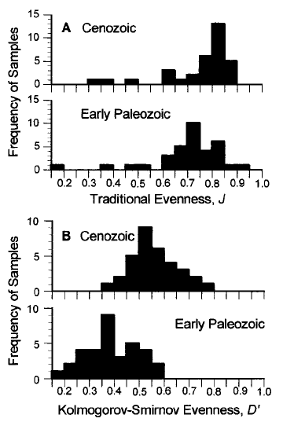
Further evenness and sampling-standardized approaches
Bush and Bambach (2004, J. Geology)
Powell & Kowalewski (2002, Geology)

Slide 37
Alpha Diversity Through Time: Rarefaction
Jurassic
Rarefaction of 400 samples
Standardized to 30 individuals
Neogene
Kowalewski et al. (2006, Paleobiology)

Slide 38
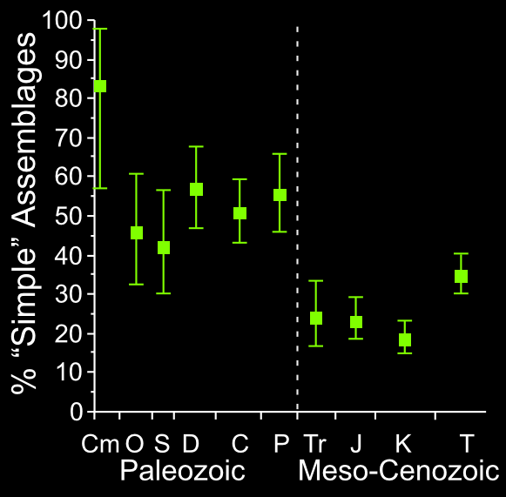
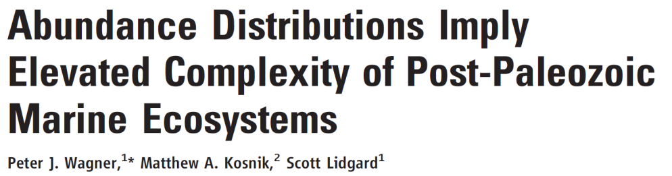
Alpha Diversity Trend Through RADs
Proportion of complex communities „suddenly“ rising after P/T boundary
Simple = Geometric series or zero-sum multinomial
Complex = Lognormal or Zipf
Wagner et al. (2006, Science)

Slide 39

Break

Slide 40
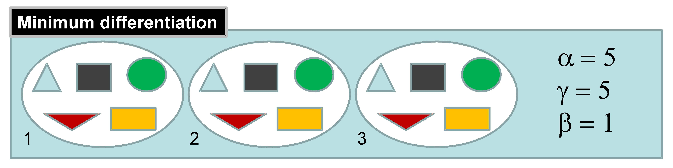
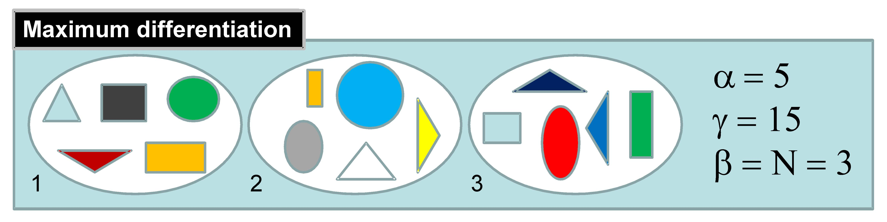
Beta diversity
https://methodsblog.com/2015/05/27/beta_diversity/

Slide 41
Beta Diversity
Assessed indirectly
Beta = Gamma/mean(Alpha)
Assessed directly
By dissimilarities between communities
Use a suitable dissimilarity metric

Slide 42
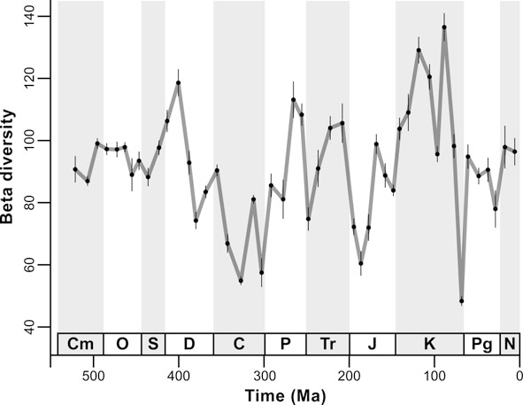
Beta Diversity Through Time
Unweigthed by-list subsampling of PBDB data
Beta = Gamma/Mean Alpha
Aberhan & Kiessling (2012)

Slide 43
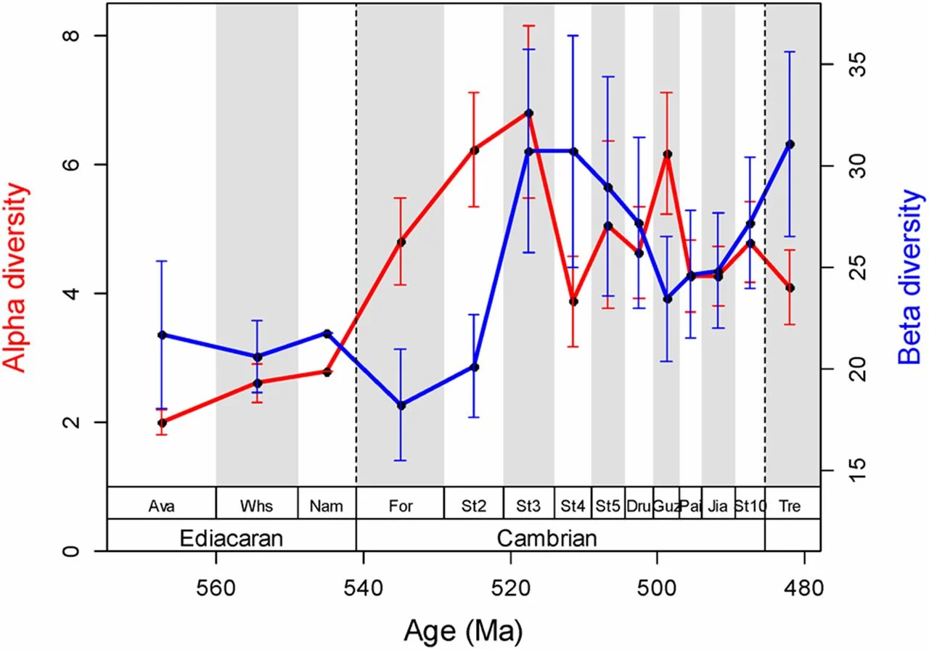
Alpha and Beta in the Cambrian Explosion
Lin and Kiessling (2015, PNAS)

Slide 44
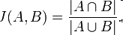
Similarity Indices to Approach Beta Diversity
Jaccard Index:
S_{j} = a/(a+b+c)
a = Number of shared taxa between sampling sites
b = Number of taxa in site A not encountered in site B
c = Number of taxa in site B not encountered in site A
Jaccard Dissimilarity = 1 - S_{j}
Good for binary data but very sensitive of different sample sizes

Slide 45
Nestedness and turnover components of beta diversity
Baselga (2010)

Slide 46
Other binary metrics
Sørensen pairwise dissimilarity
β_{Sor} = (b + c)/(2a + b + c)
Linear relationship with Whittaker’s beta
True turnover
Simpson pairwise dissimilarity
β_{Sim} = min(b,c)/(a + min(b,c))
Turnover without richness component
Nestedness (Baselga 2010)
β_{nes} = β_{sor} - β_{sim}

Slide 47
Percent similarity
Percent similarity: P = Σ min(p_{i1}, p_{i2})
Simple and very efficient for quantitative data, same as Bray-Curtis for proportional data
I J min
A 50 80 50
B 20 0 0
C 30 20 20
70%

Slide 48
Exercise
Calculate beta diversity of radiolarian faunas?
Start with two samples and then go to entire matrix
Script: Beta_div.R
Notes:
In Zukunft Studenten selbst

Slide 49
What to do with a (dis)similarity matrix
Structure detection
Explore groups versus gradients over space and time
Approaches
Cluster analysis
Non-metric multidimensional scaling

Slide 50
Hierarchical Cluster Analysis
Hierarchical (nested) grouping of data
Between variables (Q-Mode)
Between cases (R-Mode)
Paleobiological
Q-Mode: Groups of samples
R-Mode: Groups of species or higher taxa
Divisive or agglomerative
Fully reproducible
Works with any similarity or distance metric

Slide 51
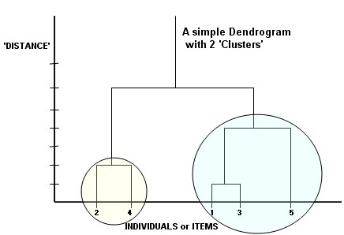
Steps in Cluster Analysis
Similarity/Dissimilarity (or distance) matrix
Agglomeration: Link pairs of objects to form small clusters
Treat small clusters as new objects and repeat procedure until all objects are related

Slide 52
Agglomeration Methods (Selection)
Nearest Neighbor or Single Linkage Clustering: Similarity between two clusters equals the maximum similarity between any two members of the clusters
Tends to produce chaining (friends of friends)
Farthest Neighbor or Complete Linkage Clustering: Similarity between two clusters equals the minimum similarity between any two members of the clusters
Tends to produce clear groups, even if similarity between members is great
Default method in R function hclust()
Unweighted Group Average or Unweighted Pair Group Method with Arithmetic Averaging: Similarity between two clusters equals the mean similarity between all possible pair-group combinations
Intermediate between single and complete. Most commonly used in paleoecology
Centroid Clustering or Unweighted Pair Group Method with Centroid Averaging: Similarity between two clusters equals their similarities as composite objects
Ward’s Method: Objects are grouped that minimize the variance of the similarities between all member objects within a cluster
Recommended method
ward.D2 in R

Slide 53
Exercise
Find the biogeographic structure in Late Jurassic-earliest Cretaceous radiolarian samples collected from
Antarctica (K, GD, LG)
The Alps (AM, Bu, PS, Sc, Sg, Stg)
Oman (JB, JH, Na)
Philippines (R)
Biogeographic vs. stratigraphic signal?
Alps: Callovian to early Tithonian
Oman: Berriasian-Valanginian
Antarctica: Kimmeridgian-Berriasian

Slide 54
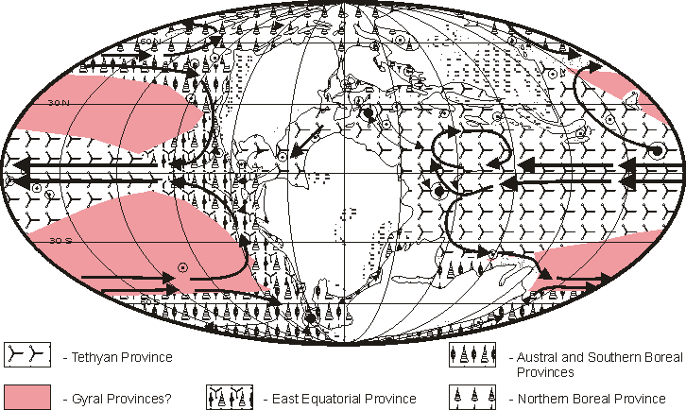
Reconstructed Radiolarian Provinces in the Tithonian
Kiessling (1999, Micropaleontology)

Slide 56
Ordination
Complementary to clustering but
Allows better representation of larger distances
Objects arranged on continuous axes
No forced hierarchical structure
Shapes of clusters can be seen (if real)
Gradients can be seen (if real)
Explorative rather than for hypothesis testing
Principal Component and Factor Analysis
(Detrended) Correspondence Analysis
Multidimensional Scaling

Slide 57
Principal Component Analysis (PCA)
Orthogonal transformation of several potentially correlated variables into a (reduced) set of uncorrelated variables, the principal components (PCs)
Number of PCs is ideally much less than original set of variables
PCs extracted in successive form such that each explains the maximum (remaining) variance of the whole dataset
Factor analysis is a specific case of PCA
PCA most commonly applied in morphometrics

Slide 58
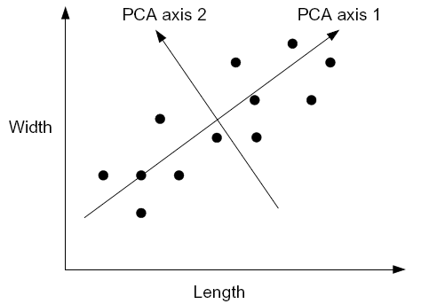
Example
Length and width of shark teeth in a species
Values well correlated but high variance
Rotate coordinate system to achieve the minimum variance
Interpretation of new axes (PCs):
Axis 1: Size, Axis 2: Width-Length ratio

Slide 59
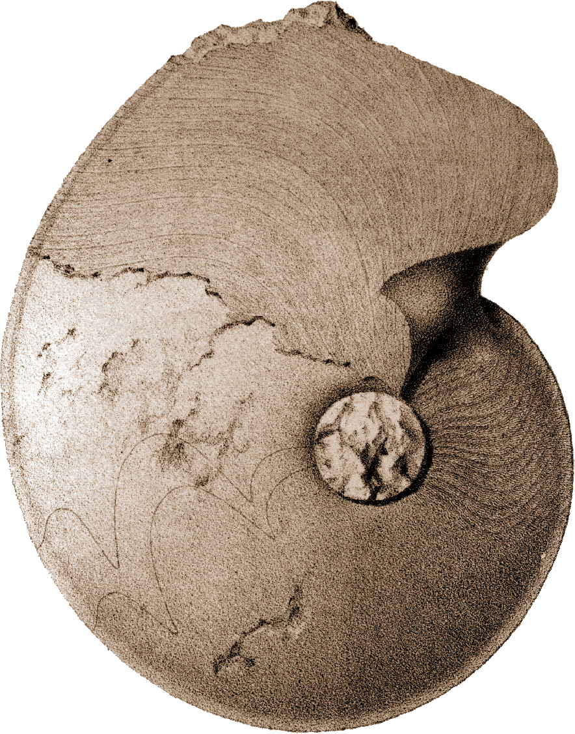

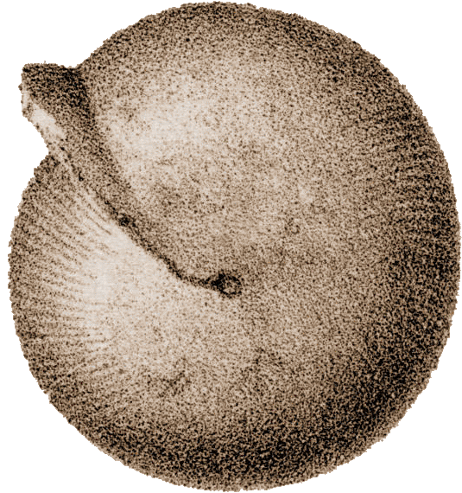
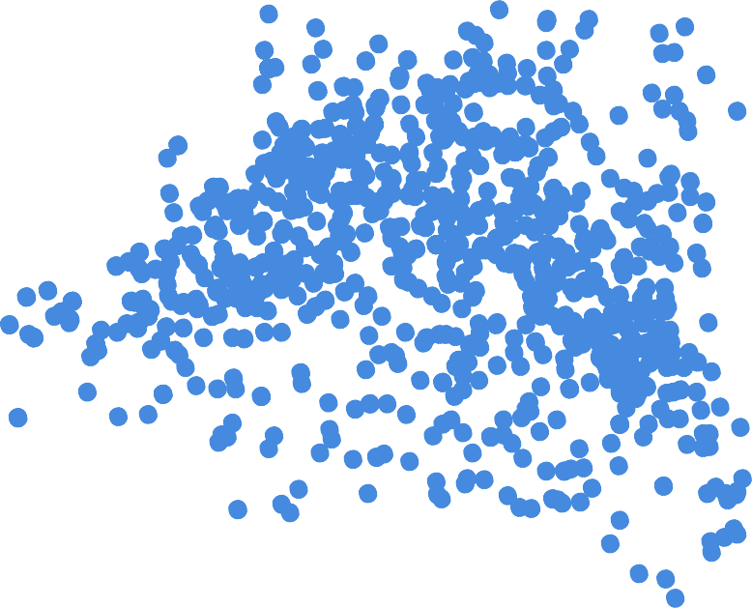
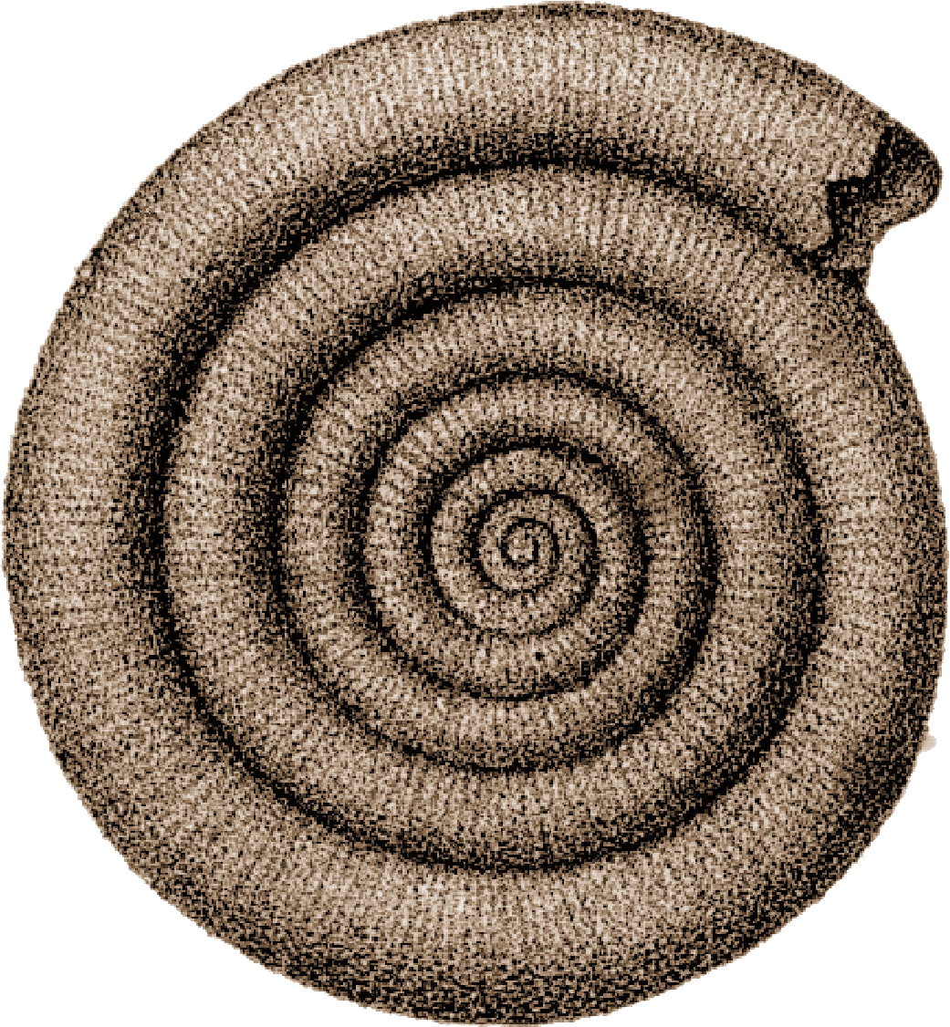
Morphometrics of ammonoids, PCA
5
4
3
B
2
distribution of Devonian ammonoids in the PC1 / PC2 scatter diagram and most important conch morphologies
PC 2
1
D
0
C
-1
A
-2
-3
-3
-2
-1
0
PC 1
1
2
3

Slide 60
Multidimensional Scaling (MDS)
An ordination technique in which the scatter of points representing samples or taxa in an ordination space is iteratively allowed to evolve until it resembles the observed dissimilarity matrix as closely as possible
Two methods
Metric (MDS): Actual values of dissimilarity are considered (aka Principal Coordinate Analysis)
Non-metric (NMDS): The ranking of dissimilarity is analyzed
Basic steps
Dissimilarity or distance matrix of objects
Specify dimensionality (usually 2D or 3D)
Project or squeeze distances on the ordination space and identify the stress this imposes
Minimize the stress by moving points in ordination space
Note: Axes are arbitrary and can be rotated as wished

Slide 61
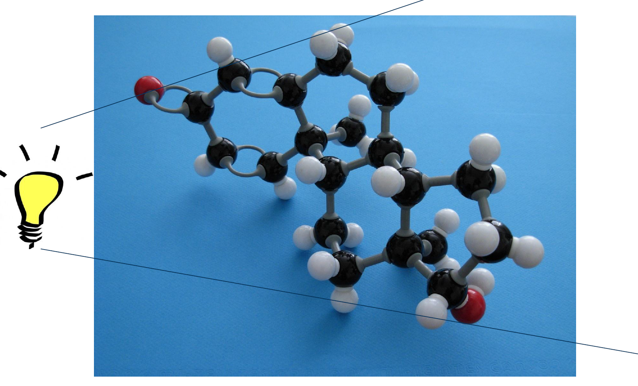
MDS (Metric = Parametric)
Projection on a plane

Slide 62
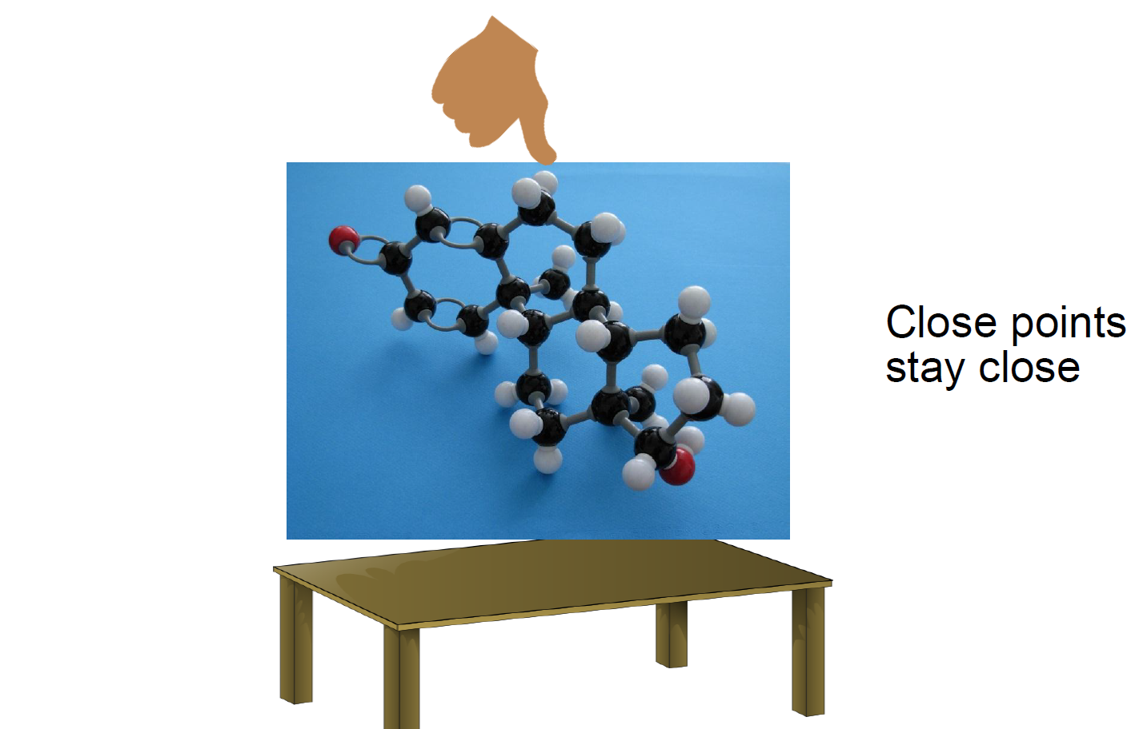
NMDS (Non-metric = non-parametric)
Squeezing on a plane

Slide 63
A simple example of MDS (Principal Coordinate Analysis)
Given: Distances of European Cities
Task: Calculate a map of Europe with just these data
eurodist
loc <- cmdscale(eurodist, k =2)
plot(loc, type="n")
text(loc, rownames(loc), cex = 0.6)
Relative positions are correct but true coordinates are wrong
Change this by transforming one variable
x <- loc[, 1]
y <- -loc[, 2]
plot(x, y, type = "n", xlab = "", ylab = "", asp = 1, axes = FALSE, main = "cmdscale(eurodist)")
text(x, y, rownames(loc), cex = 0.6)

Slide 65
Try With Radiolarian Data
As in metric approaches, the first axis explains most of the variance, but there is no strict “% variance explained”
Compare with metric

Slide 66
Stress: How much pressure is needed to squeeze multidimensional object on two (or three) dimensions?
With metaMDS: Stress values >0.2 are generally poor and potentially uninterpretable; values <0.1 are good and <0.05 are excellent, leaving little danger of misinterpretation.
Stress values between 0.1 and 0.2 are useable but some of the distances will be misleading.
mMDS$stress
# Evaluate scatter around the regression between the interpoint distances in the final configuration
stressplot(mMDS) # how well does the two-dimensional distance correspond to the true distance?

Slide 67
Sites and species together
plot(mMDS)

Slide 68
Metric MDS and grouping
Oman
Antarctica
Alps, Philippines

Slide 69
Main Assignment
Paleoecological data are provided for the middle Triassic of South China
Compute patterns of alpha and beta diversity across all samples
Are there distinct groups of samples?
Is group membership predicted by diversity or other ecological properties?
How good is the Berger-Parker-Index to predict more complex measures of diversity such as Shannon’s H?

Slide 70
Get started
Calculate beta diversity of Triassic faunas
Use matrix
Script: Beta_div_Bangtoupo.R
Notes:
In Zukunft Studenten selbst

